Slide 1
STEP TRAINING PRESENTATION
ADD AN OBSERVATION

Slide 2
AGENDA
PURPOSE
BEFORE YOU START
INITIAL LOG IN
ADD AN OBSERVATION
UPDATE AN OBSERVATION
FIND/EDIT AN OBSERVATION
CONCLUSION

Slide 3
PURPOSE
For an observer to properly add a STEP observation into the SafetyNet database using a laptop or desktop computer.

Slide 4
BEFORE YOU START
Information needed for an observation to be input:
A completed checklist from a recent STEP Observation.
A username and password to log into SafetyNet.

Slide 5
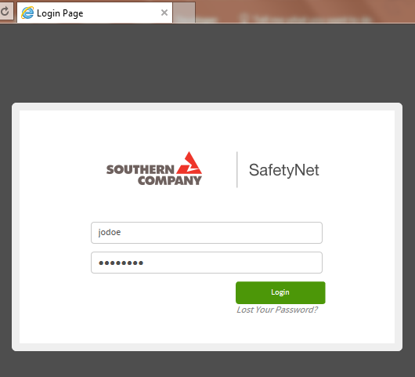
Log Into SafetyNet
Login using your assigned username and password to access SafetyNet Database.

Slide 6
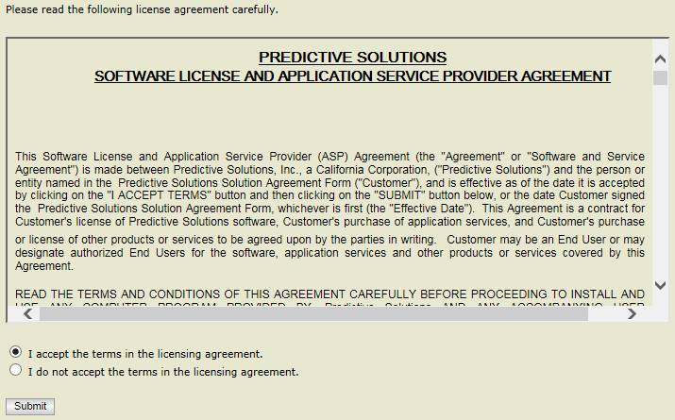
INITIAL LOG IN
When logging in for the first time must read & accept the licensing agreement and submit before proceeding.

Slide 7
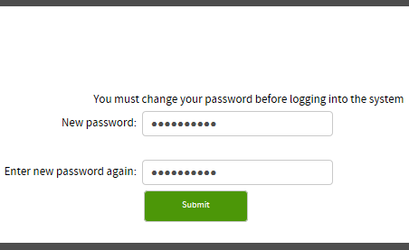
INITIAL LOG IN
You will be required to change your password prior to logging into SafetyNet.

Slide 8
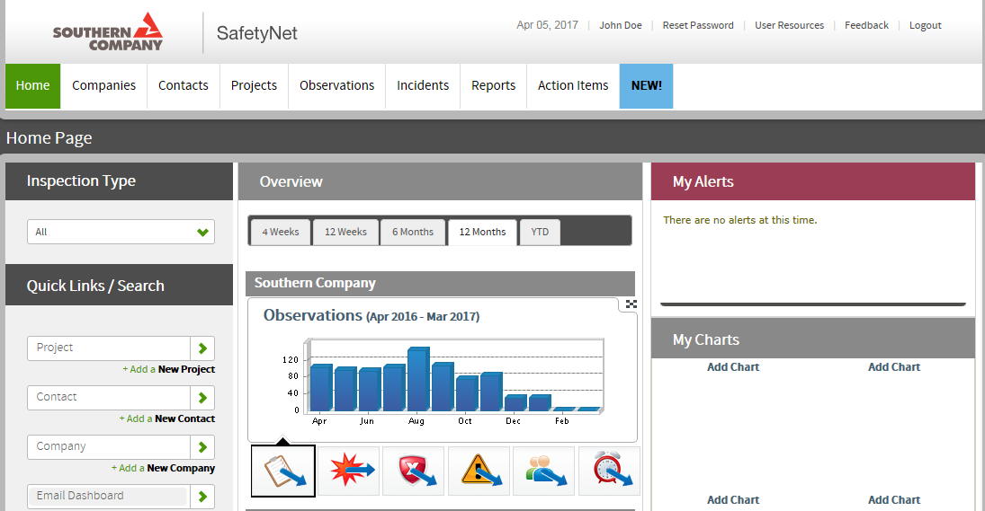
INITIAL LOG IN
Dashboard Screen

Slide 9
ADD AN OBSERVATION
Hover above the Observations tab and select Add Observation.
NOTE
To print an observation checklist select Print Forms and select the desired checklist. Export it to Word or PDF and print.

Slide 10
ADD AN OBSERVATION
Begin typing the project name and projects you are assigned to (with that spelling) will auto-populate. Select the desired project.

Slide 11
ADD AN OBSERVATION
Select the Observation date field and the current month will appear. Select the date of the observation.
Note
Month and year can be changed.

Slide 12
ADD AN OBSERVATION
Select the Hour, Minute, and AM/PM field to set the time the observation was conducted.

Slide 13
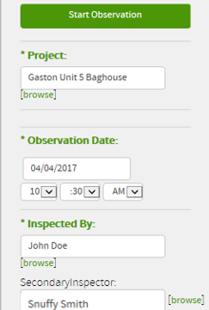
ADD AN OBSERVATION
During a Paired Observation add the name of the other observer in the Secondary Inspector field. Select
Start Observation
Note
Secondary Inspector must be a trained observer who is in SafetyNet.

Slide 14
ADD AN OBSERVATION
Select the Observation Type field and click on the desired observation type. Select STEP for a STEP Observation.

Slide 15
ADD AN OBSERVATION
Select the Contractor field to choose the contractor or area to be observed. The Observation Screen will automatically appear.

Slide 16
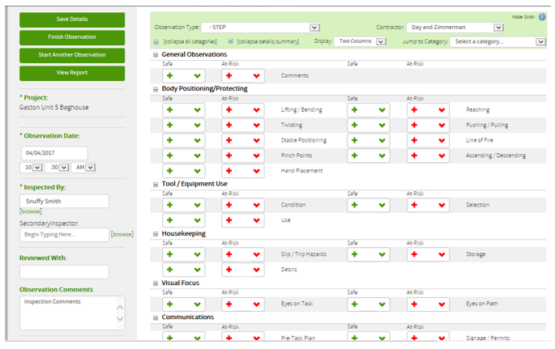
OBSERVATION SCREEN

Slide 17
ADD AN OBSERVATION
Observation Comments
Provide general information about the observation in the Observation Comments Field.

Slide 18
ADD AN OBSERVATION
The General Observations section is used to enter any behavior, condition, or process not covered by the STEP observation checklist.

Slide 19
ADD AN OBSERVATION
When entering a safe behavior click the plus symbol. Each time the + is selected the number increases by 1.
Press CTRL + click the plus symbol to add comments to a safe behavior or click the down arrow and select the word ‘Safe’.

Slide 20
ADD AN OBSERVATION
To delete a safe behavior select the down arrow and click on an entry.
Select Delete and click Ok to delete behavior when confirmation box appears.

Slide 21
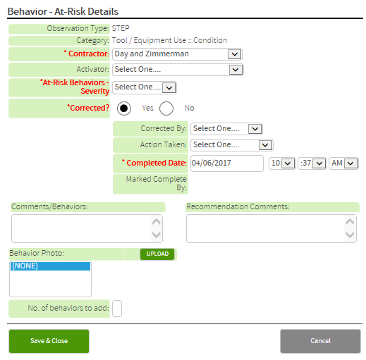
ADD AN OBSERVATION
For an At-Risk Behavior, select the + and the Behaviors – At-Risk Details window will appear.

Slide 22
ADD AN OBSERVATION
Select the down arrow for Activator and choose the reason you believe the At-Risk behavior occurred based on what you saw and your conversation with people in the area.

Slide 23
ADD AN OBSERVATION
Select the down arrow for At-Risk Behaviors – Severity choose Low, Medium, High, or Life Threat based on the probability of an injury, the likely severity of that injury, and your conversation with people in the area.

Slide 24
Define Severity
Probability
Low
Medium
High
Life Threat
Low
High
Low
Severity
High
Notes:
Here is how we will define severity…with examples to follow.

Slide 25
ADD AN OBSERVATION
If the at-risk behavior was corrected select Corrected By and select who made the correction. Select Action Taken and choose the closest related action from the menu.

Slide 26
ADD AN OBSERVATION
Select the Completion Date, Hour, Minute, and AM/PM field to enter information for when the correction was completed.

Slide 27
ADD AN OBSERVATION
If the at-risk behavior was not corrected select Assigned To and select who will make the correction. Select Action Required and choose the closest related action for correction.

Slide 28
ADD AN OBSERVATION
Select Due Date and enter a future date for correction completion.
This behavior will now show up as an Open Item in SafetyNet until it is corrected and closed out.

Slide 29
ADD AN OBSERVATION
In the Comments/Behaviors field add comments concerning the at-risk behavior which was observed.
In the Recommendation Comments field add details of the conversation about the at-risk behavior and corrections or plans for corrections.

Slide 30
ADD AN OBSERVATION
To add a Behavior Photo or Corrected Photo select UPLOAD for your choice and a SafetyNet – Browse for Images window will open.

Slide 31
ADD AN OBSERVATION
Select Pictures and choose the desired photo. View photo information in the File field. Add Image Name and Description if desired and Submit.

Slide 32
ADD AN OBSERVATION
If the behavior was observed once click Save & Close. If this behavior occurred more than once during this observation input that number in the No. of Behaviors to add field then click Save & Close.

Slide 33
ADD AN OBSERVATION
Repeat these processes for each behavior observed in every category of the STEP observation until all behaviors are input.
Select Finish Observation to complete the observation input.

Slide 34
UPDATE AN OBSERVATION
EDIT/CLOSE-OUT AN OPEN ITEM

Slide 35
UPDATE AN OBSERVATION
(EDIT/CLOSE-OUT AN OPEN ITEM)
To close out an Open Item hover above the Reports tab and select Open Issues Report.

Slide 36
UPDATE AN OBSERVATION
(EDIT/CLOSE-OUT AN OPEN ITEM)
All open items for this observer will display on this page. Select ‘Edit’ to update or close out an open item.

Slide 37
UPDATE AN OBSERVATION
(EDIT/CLOSE-OUT AN OPEN ITEM)
If an item has not been corrected, add the information and click Save & Close. Do not erase any of the initial information.

Slide 38
UPDATE AN OBSERVATION
(EDIT/CLOSE-OUT AN OPEN ITEM)
If corrected, select Yes, add the information, and Save & Close. Do not erase the initial information. This item will no longer show as an open.

Slide 39
FIND/EDIT AN OBSERVATION

Slide 40
FIND AN OBSERVATION
To find an observation hover above the Observations tab and select Find Observation.

Slide 41
FIND AN OBSERVATION
Select the type of observation desired.

Slide 42
FIND AN OBSERVATION
Type the project name if you wish to see observations from that project only regardless of observer.

Slide 43
FIND AN OBSERVATION
Type the observer in the Inspector field if you wish to see observations from that observer only regardless of project .
NOTE: Select project and observer to search for project and observer specific observations.

Slide 44
FIND AN OBSERVATION
Select the Observation Date Range.

Slide 45
FIND AN OBSERVATION
Select the observation.

Slide 46
EDIT AN OBSERVATION
To edit, select the Observation Type field and click on the type of observation that needs to be edited.

Slide 47
EDIT AN OBSERVATION
(CLOSE-OUT AN OPEN ITEM)
Select the Contractor field to choose the observed contractor or area where the observation was conducted.

Slide 48
The contractor/area above was incorrect.
Correct selection will show observation info.

Slide 49
EDIT AN OBSERVATION
Click on the down arrow and select the behavior you would like to edit. Safe and At-Risk Behaviors are edited in this manner.

Slide 50
EDIT AN OBSERVATION
After you have edited the behavior click Save & Close.
Repeat this process until all desired changes are made. Click Finish Observation to complete the process.

Slide 51
CONCLUSION
You have been taken through the process of:
INITIAL LOG IN
ADDING AN OBSERVATION
UPDATING AN OBSERVATION
FINDING/EDITING AN OBSERVATION

Slide 52
People Power Safety

